Slide 1
Website for DNA Classification and sequence alignment

Slide 2
Team Members:
Muhammad Ehab Muhammad Khalil
Muhammad Medhat Abdel-rady
Amr Muhammad Gaber
Habeba Allah Adnan Ahmed
Reem Osama Abdel Moneim

Slide 3
Website Overview
Our website distributed into 3 main pages:
DNA Sequence Classifier page: In this page we are looking forward to providing a simple tool for DNA sequencing classifier using machine learning model
Global & Local Sequence Alignment pages: the main purpose of these spectacular tools to get the alignment score matrix in an amazing way with highlighted traceback path , alignment score, alignment sequence, and all possible alignments.

Slide 4
DNA Sequence Classifier Introduction
DNA sequence is a popular concept in both academic research and practical applications, such as gene traceability, species identification, and disease diagnosis. Whereas all industries starve for a more intelligent and efficient research method, artificial intelligence has attracted much attention especially from biological and medical domain. More and more scientists and researchers are contributing to machine learning and deep learning in bioinformatics. To make experimental results more convincing.

Slide 5
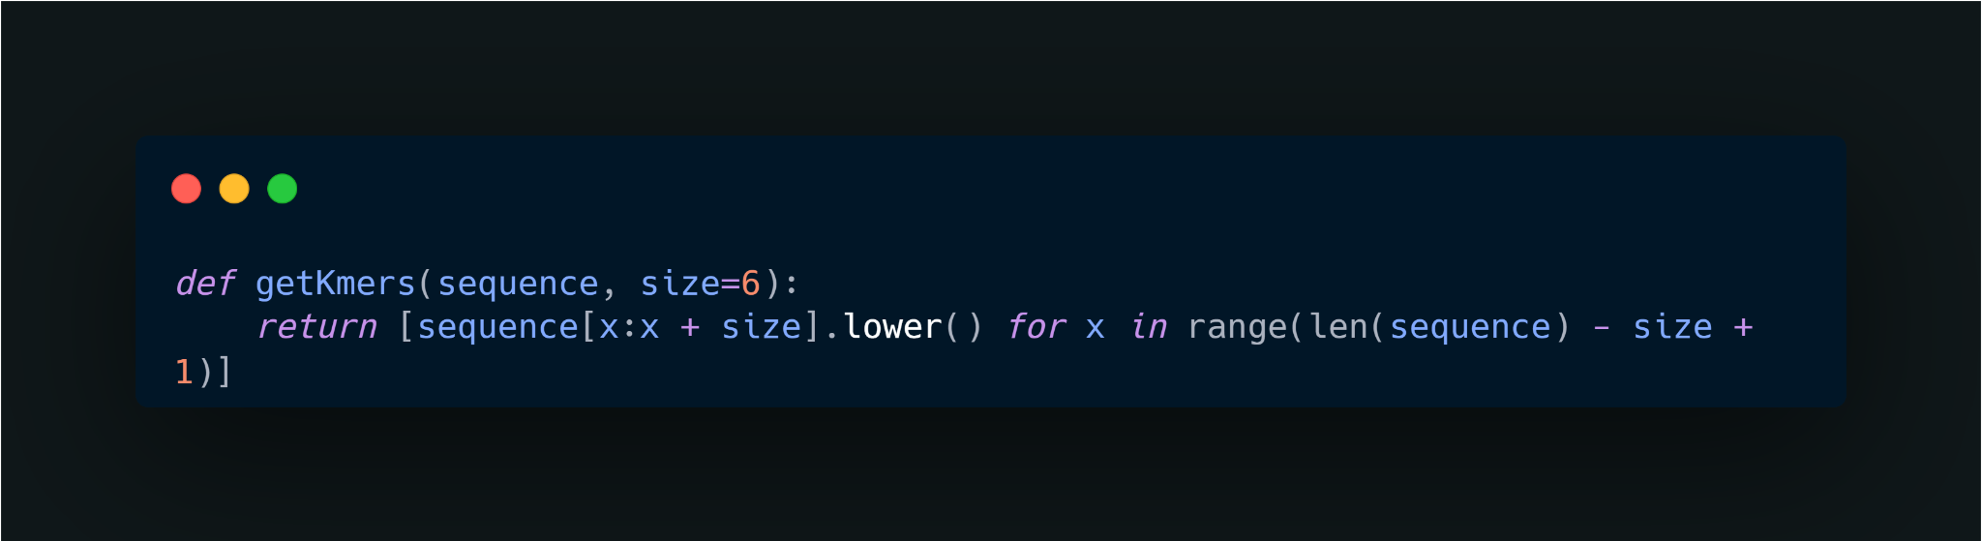
Main Points of DNA Sequence Classifier
K-mer
The k-mer method is commonly used in DNA sequence preprocessing. It extracts a small section of length k starting from each base of the original sequence, thereby converting a long sequence of length s to (s-k+1) short sequences of length k. Adjusting the value of k will improve the model performance. Lists of short sequences are easier for data reading, feature extraction, and vectorization.

Slide 6
Main Points of DNA Sequence Classifier
Vectorization
DNA sequences are vectorized in the form of text. A sequence transformed by k-mer becomes a list of short sequences, which looks like a list of individual words in a sentence. Therefore, most natural language processing models should work for DNA sequence data as well. Similar methodologies can be applied to model training, feature extraction, and encoding. Since each model has its own advantages and drawbacks, the selection of models depends on the feature of data and the purpose of research. For example, CountVectorizer, a bag-of-words model, implements feature extraction through straightforward tokenization.

Slide 7
Main Points of DNA Sequence Classifier
Vectorization
DNA sequences are vectorized in the form of text. A sequence transformed by k-mer becomes a list of short sequences, which looks like a list of individual words in a sentence. Therefore, most natural language processing models should work for DNA sequence data as well. Similar methodologies can be applied to model training, feature extraction, and encoding. Since each model has its own advantages and drawbacks, the selection of models depends on the feature of data and the purpose of research. For example, CountVectorizer, a bag-of-words model, implements feature extraction through straightforward tokenization.

Slide 8
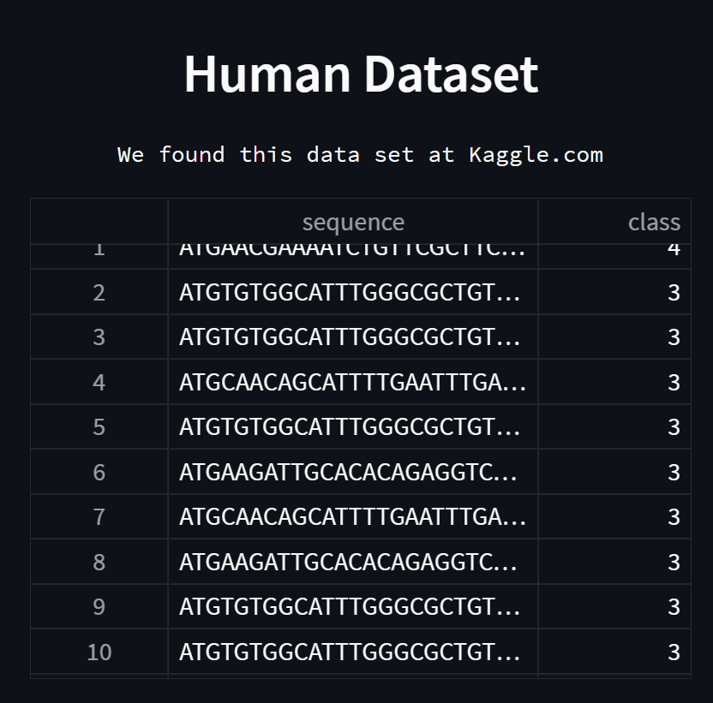
Snippet From Our Website
We have collected this dataset from the Kaggle repository. This dataset is available as public. The name of this dataset is “human_data.txt”. The dataset contain two features one is deoxyribonucleic acid (DNA)sequencing and another one is class. The size of this dataset is (4380,2) where 4380 is the number of samples and 2 is the number of columns. Below, the dataset shown in Fig.

Slide 9
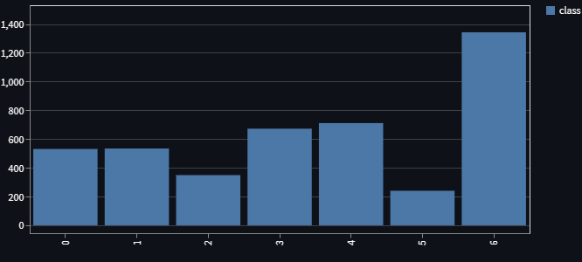
Snippet From Our Website
we have sketched one count plot to plot the occurrences per class have. The transcription factor (class 6) has the most data among all 7 classes and the number is 1343. The lowest class is the Lon channel which has 240 samples.

Slide 10
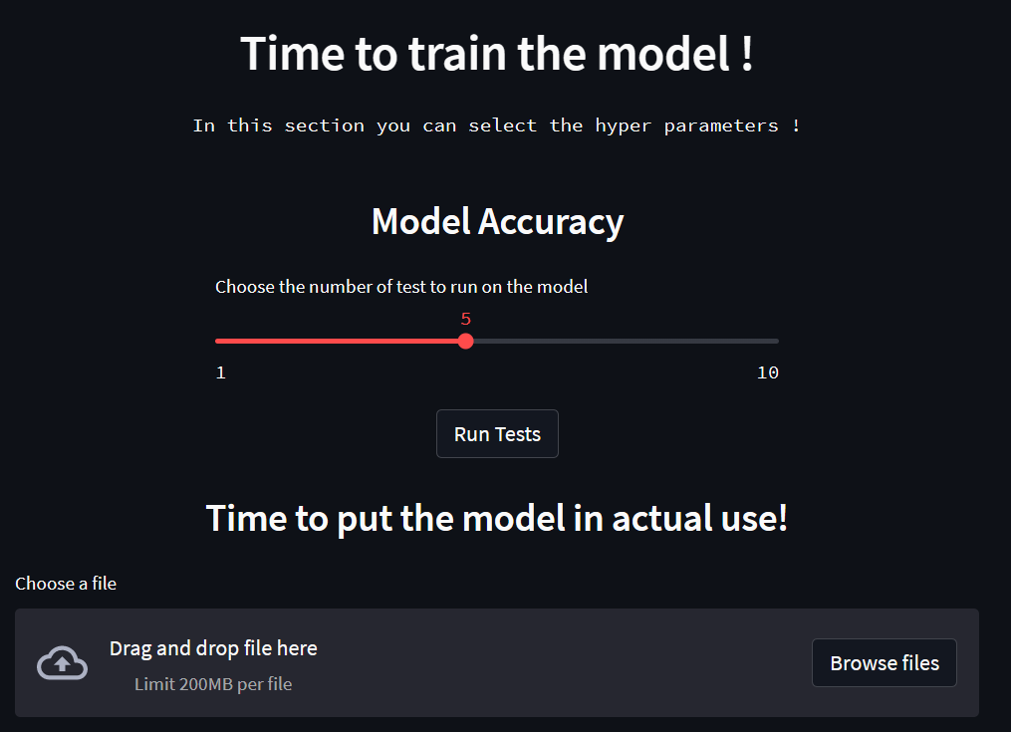
Snippet From Our Website
Calculating our model’s accuracy & testing the user’s data.

Slide 11
Global Sequence Alignment
The main purpose of these spectacular tools to get the alignment score matrix in an amazing way with highlighted traceback path , alignment score, alignment sequence, and all possible alignments.

Slide 12
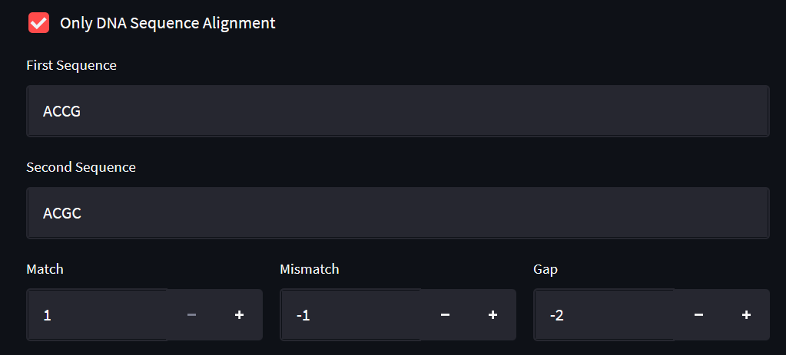
Snippet From Our Website
Scoring Schema

Slide 13
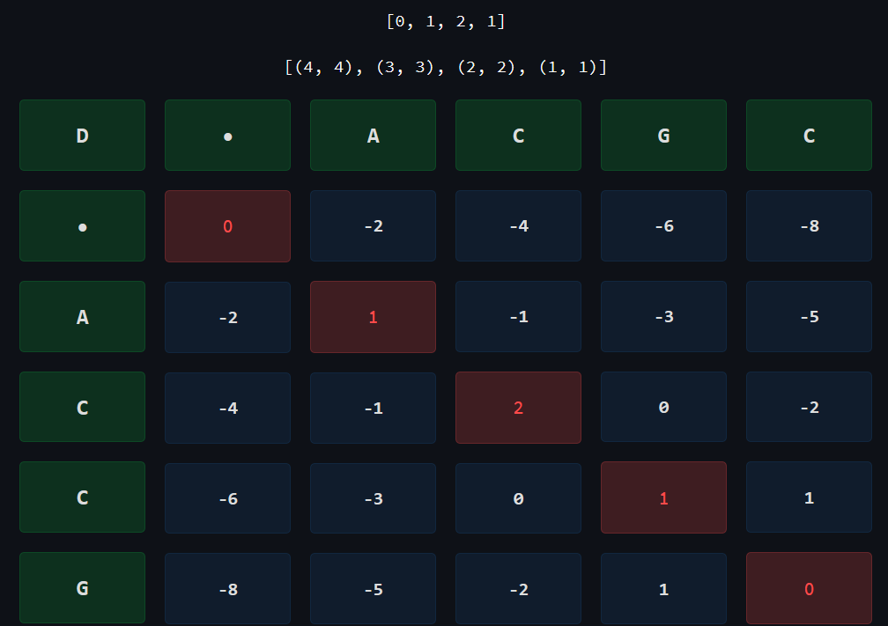
Snippet From Our Website
Alignment Traceback & position
Alignment Score
Scoring Schema

Slide 14
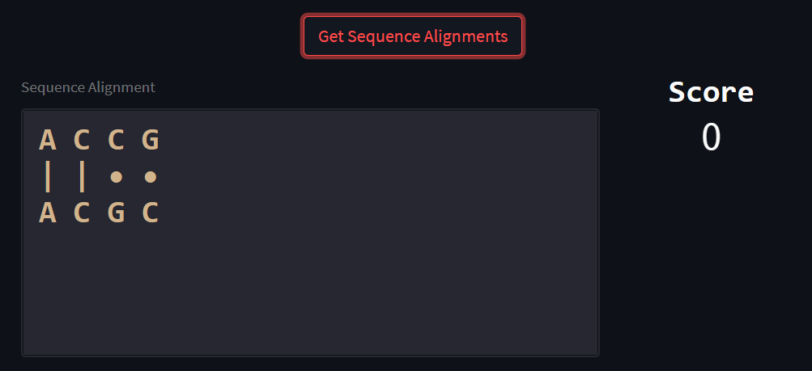
Snippet From Our Website
Sequence Alignment
Alignment Score

Slide 15
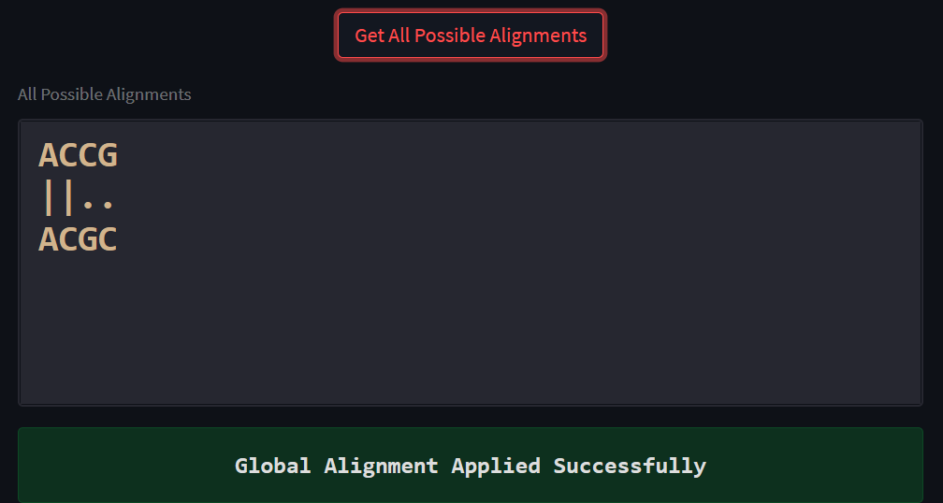
Snippet From Our Website
Display all possible sequence alignment

Slide 16
Local Sequence Alignment
The dynamic programming approach by Temple F. Smith and Michael S. Waterman (1981) computes optimal local alignments of two sequences.
So we decided to create a spectacular tool to get the alignment score matrix in an amazing way with highlighted traceback path , alignment score, alignment sequence, and all possible alignments.

Slide 17
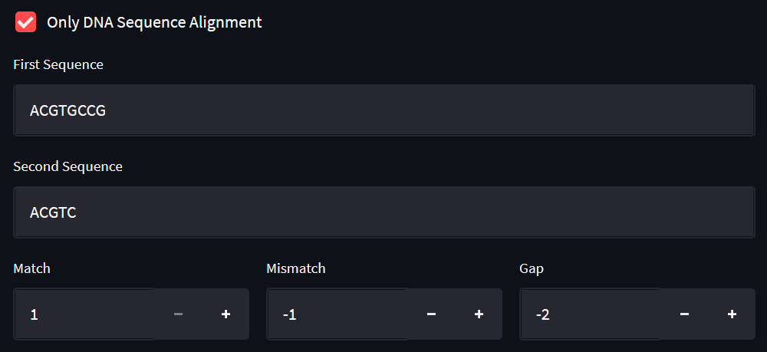
Snippet From Our Website
Give user an option to choose if he need to make the alignment on DNA only or any characters he wants.

Slide 18
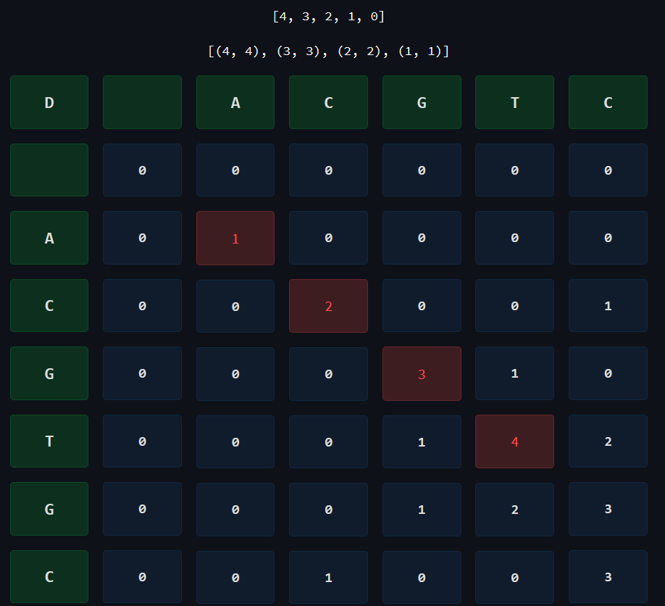
Snippet From
Our Website
Matrix Score & Traceback Path

